Slide 1
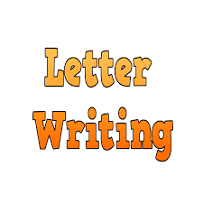
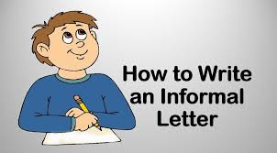

Slide 2
An informal letter is a non-official personal letter that is typically prepared to update friends and family about what is going on in your life and to communicate personal news. You can write about anything you wish to express how you feel or think. Despite the fact that it is informal, it has a specific format in which to write your expression. In this post, we’ll look at several examples of how to write an informal letter and its format.
Informal Letter
Informal letter definition is- Informal letters are written to close acquaintances of the writer, their friends, family, relatives, etc. Informal letters are personal letters that are written to let your friends or family know about what is going on in your life and to convey your regards to your family members.

Slide 3
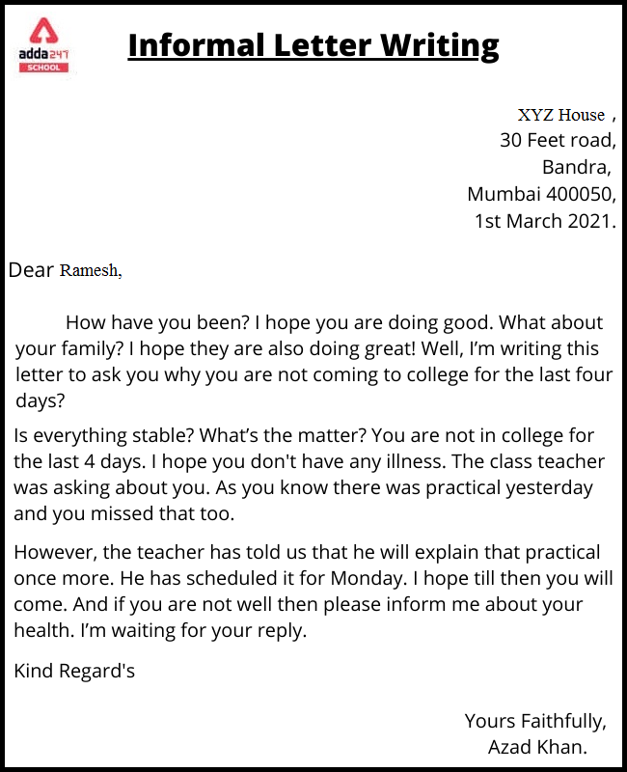
Format of Informal Letter Writing
Informal Letter Format is one of the most important things to writing a letter. One should know about Informal Letter Format writing so that one can write effectively. Formal letters are required to be written starting from school, college, up to the office.
For all official matters, one must know how to write a letter. We have mentioned the proper Informal Letter Format writing along with a short example.

Slide 4
Informal Letter Format in points
The format of an informal letter should be as follows.
Address
Date
Greetings
Introduction
Body
Conclusion
Signature.
All of the format points of an informal letter has been discussed in brief below

Slide 5
Address:
The first thing to be written while writing any letter is to have a proper address. Both the addresses of the receiver and the recipient should be present. We usually write the address on the left-hand side of the page at the top side. The address should be accurate, complete, and concise. Even when writing to close friends or relatives the address must be written, so they can reply back to the letter with ease if the reader wants to do so. If the recipient of the letter is in a foreign country, do not forget to write your country name and Pincode as well in address....

Slide 6
Date: The date should be present in which the letter is being written. This allows the reader of the informal letter have a reference as to when the date was written. He can then relate better to the contents of the letter and the time and date of the letter.
Greetings: It is the same thing as you greet someone when they visit you or you visit them. The starting of the letter should always have a greeting. Now the greeting should depend upon the person to whom you are writing the letter. If you are writing to an elderly person, then the greetings should be respectful, if you are writing to your friend you can greet them casually....

Slide 7
Introduction Paragraph:
The introduction paragraph is a must in all types of letter writing. In this paragraph, you usually make the recipient comfortable by asking them about their family wellbeing. You might begin by asking the recipient about their well-being. Or you may say that you hope the letter finds them in good health and great spirits. You also wish to find them in good health of his and their family when they receive the letter.

Slide 8
Body: You can elaborate on things for which you have written the letter. You can casually inform them of the latest happenings that took place in your life before you wrote the letter. You can also talk about other persons in your family and ask about their health.
The letter overall should maintain a friendly writing tone. But you have to adjust the language and the wordings according to whom you are writing the letter. With a friend, you can afford to be very casual and simple words even. But if you are writing to an elder relative, you must be extremely respectful and meaningful words.
One way to determine the quality of your letter is to remember how you talk to the person in a conversation. And then apply the same syntax and sentiments to the letter while writing it.

Slide 9
Conclusion: This is the ending of the letter. You wish them good luck and wrap up the letter. You may write that you wish to meet them soon enough and have long conversations. while summarizing the letter. Say meaningful and good quality words goodbye to the reader. And do not forget to invite the reader to write back or reply to your letter, it shows an intention to keep the conversation going on.

Slide 10
Signature: There are no specific words used for signature in informal letters. It depends on the writer and the recipient’s relationship. You can also use any one of the following.
Lots of Love
Best Wishes
Kind Regards
Warm Regards

Slide 11
13 AK Street
Pitampura
Delhi
12th September 2020
Dear John,
Hope you are safe and protected. It’s been a long time since we last met. I have been quite busy recently. I had a day off from work today and so decided to write a letter to you asking about you and your family.
I am fine here. I have recently started learning French and have completed few modules. Next week I am having the last exam and will be soon graduating. I also started cooking due to the lockdown and will be attaching few pictures of the dishes I learned to cook. Mom and dad are fine and they quite often miss you.
How are uncle and aunty doing? I remember you had your exams last time we had a conversation. Are the results out? What next are you planning to do? I will be waiting for your reply. Please take care of yourself and uncle, aunty.
Lots of Love
Angela.

Slide 13
Nithya Prakash /FACULTY/English/SNSACD

Slide 14
Nithya Prakash /FACULTY/English/SNSACD

